Slide 1
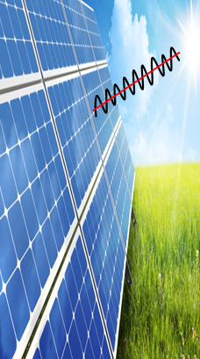
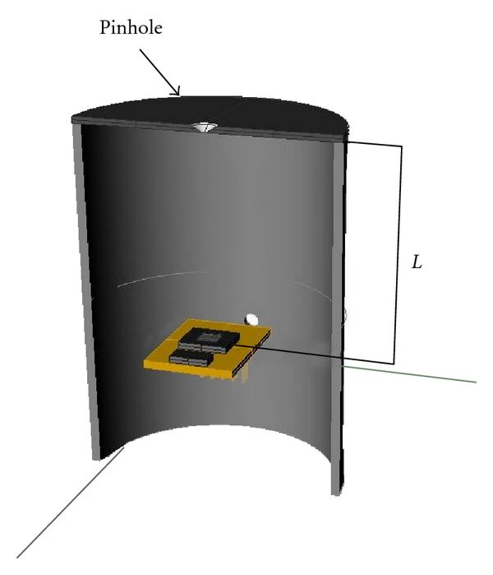

Sun Trackers Senior Design Project
Product Development
Our design takes into account the Human Interface Module allowing interactions with the integrated Embedded Systems and microcontroller. Our goal is to gather real time power data using the integrated system.
Pinhole Sensor:

Slide 2
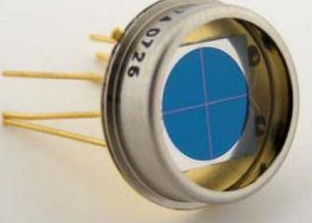
Photo Diode::
Design Features:
User Friendly
Efficient Power Usage and Storage
Human Machine Interface
NEC 70 Compliant with focus on Industry Standards
Low Cost
Data Acquisition and Storage
Self Sustaining Unit
Problem:
Fixed solar panels have inefficiencies due to the lack of direct sunlight throughout the day.
Solution:
Dual, motor operated axis solar panels have the advantage to track the sun as it travels throughout the day. Maximum power output will be achieved with the use of a microcontroller and photovoltaic sensor to control the incident angle in reference to the sun.
Company Information
The main objective of our group is to use innovative design to optimize the natural power generated from the sun more proficiently.
Made in the U.S.A

